Slide 1
The Machine Learning & Deep Learning Show
Lecture 04
21st June 2020

Slide 2
Image Classification using Neural Network

Slide 3
Image Classification using Neural Network

Slide 4


Slide 5
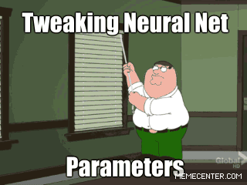

Slide 6

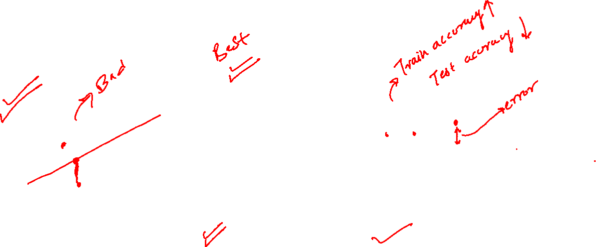

Slide 7
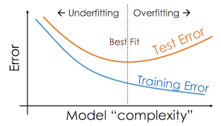
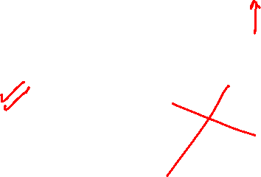

Slide 8
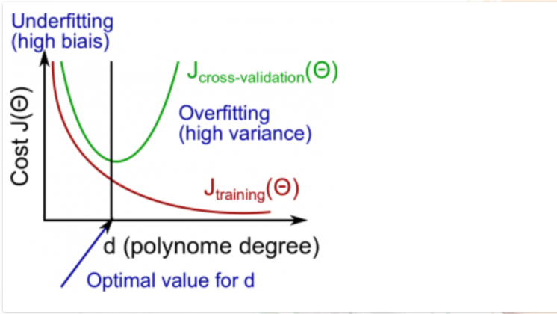

Slide 9
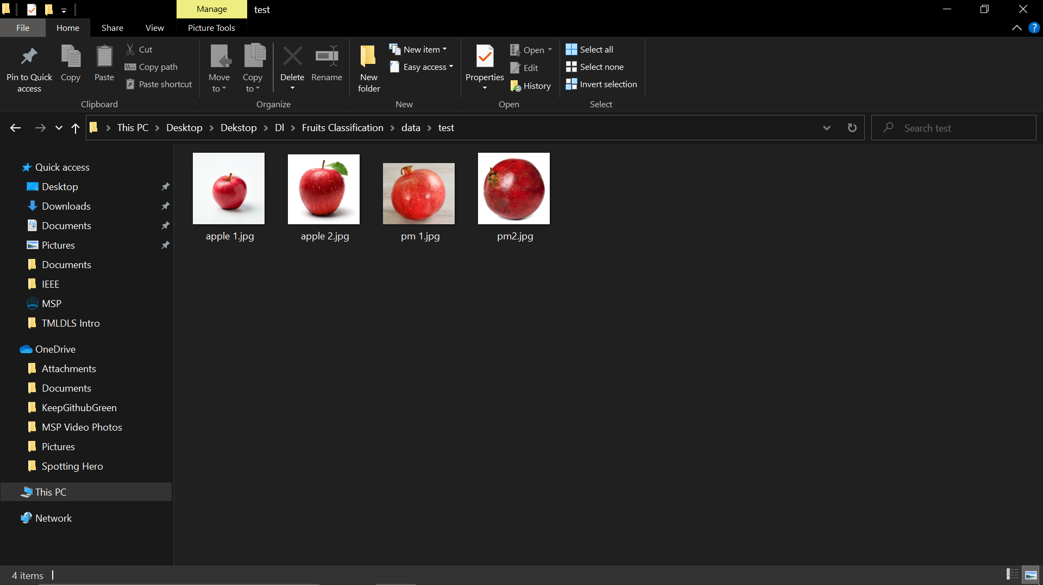
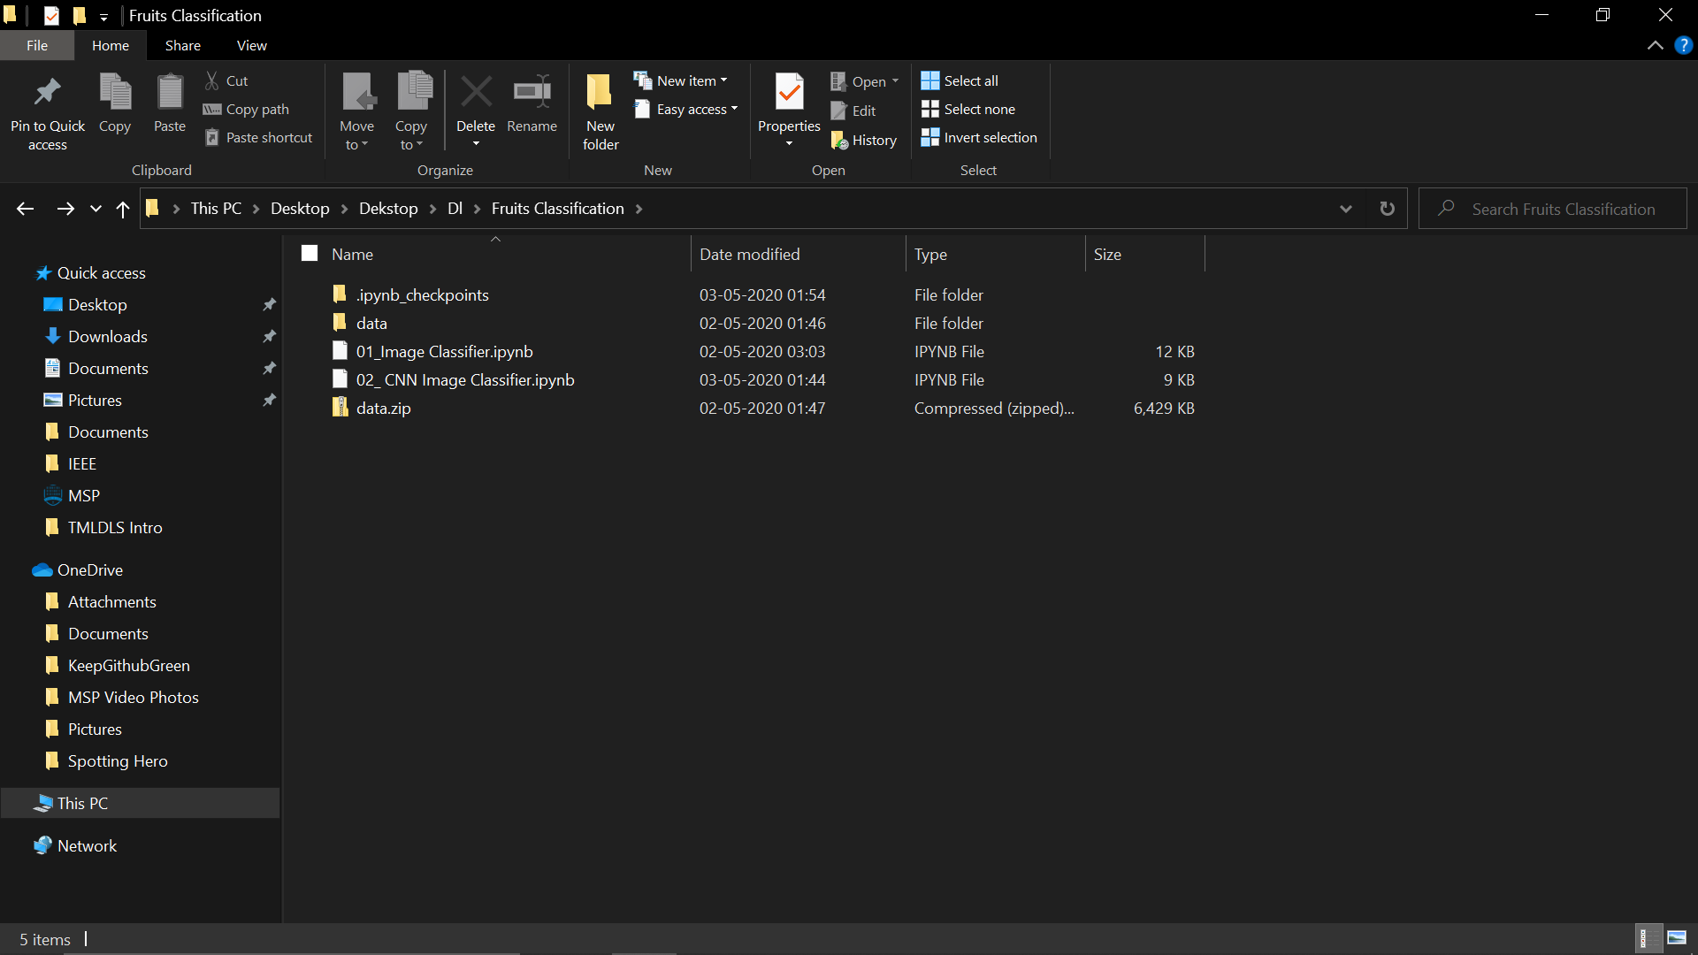
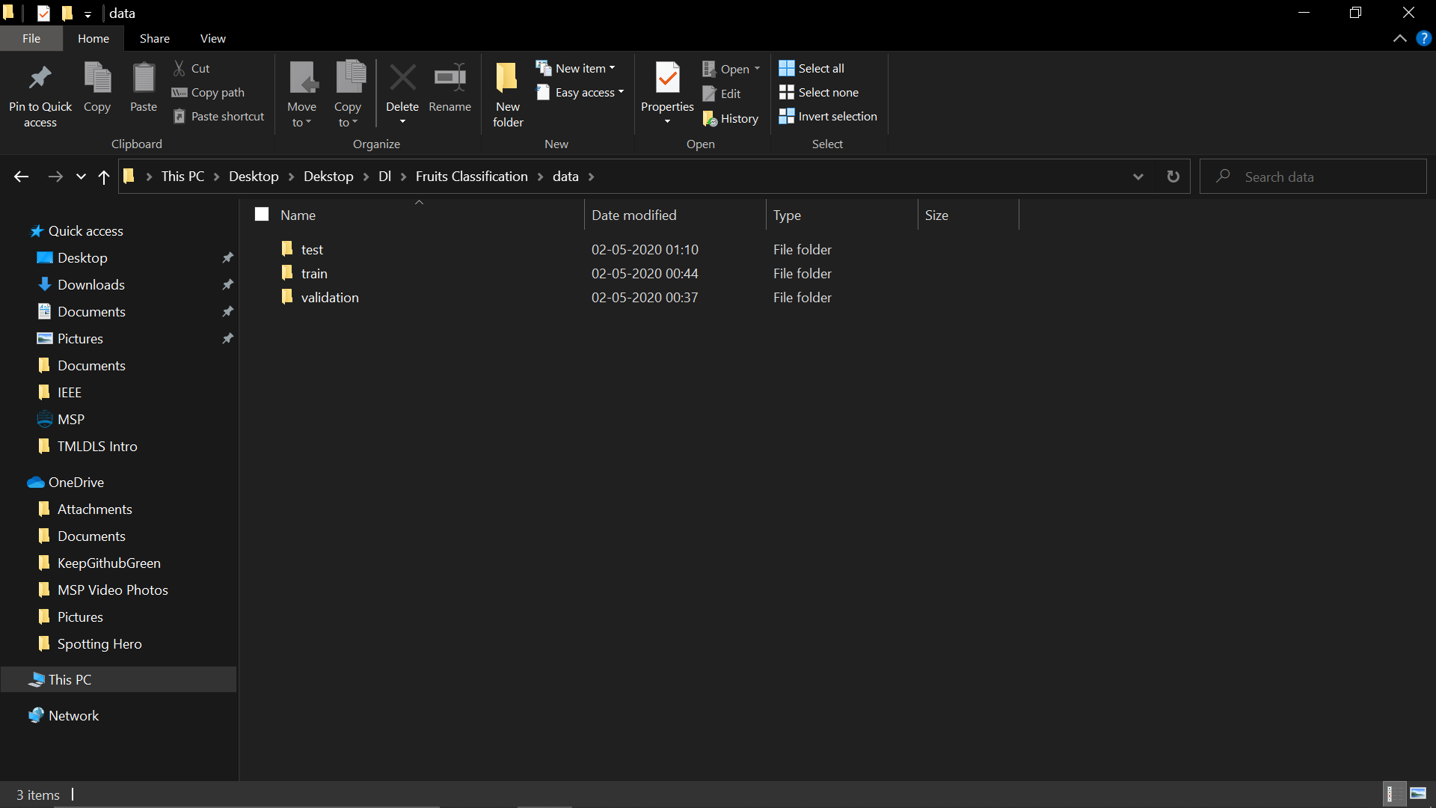
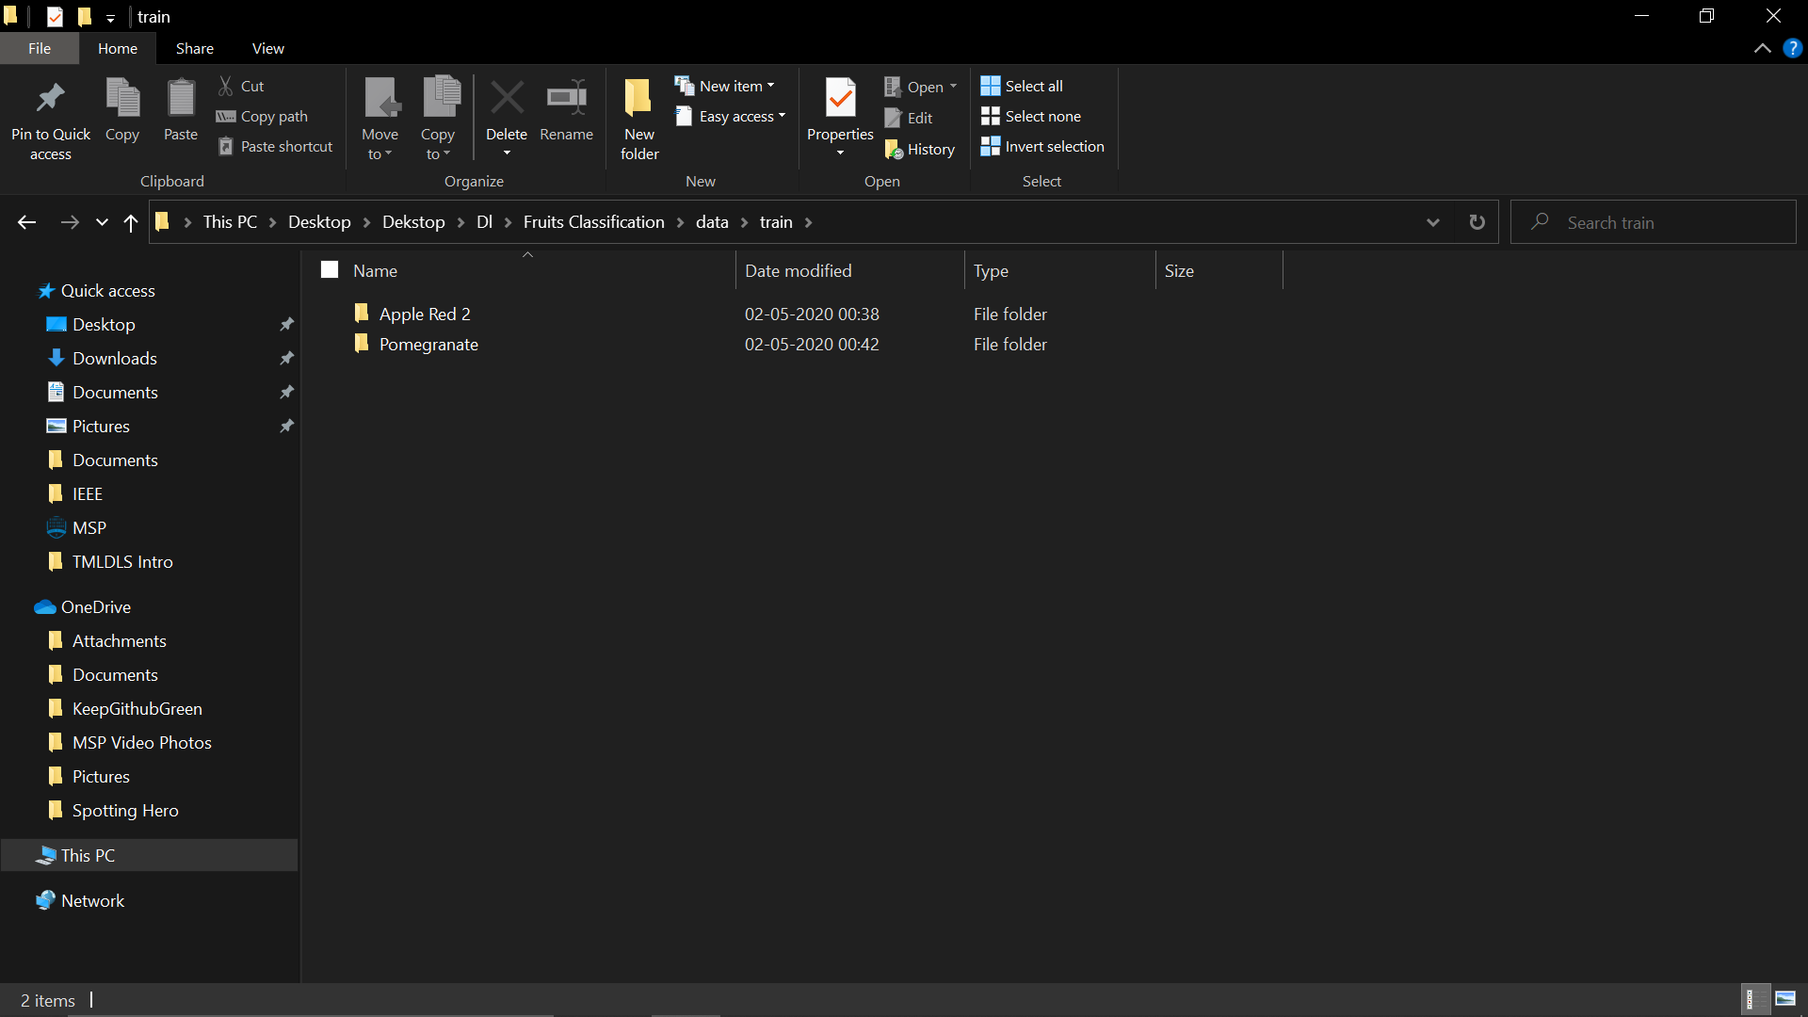
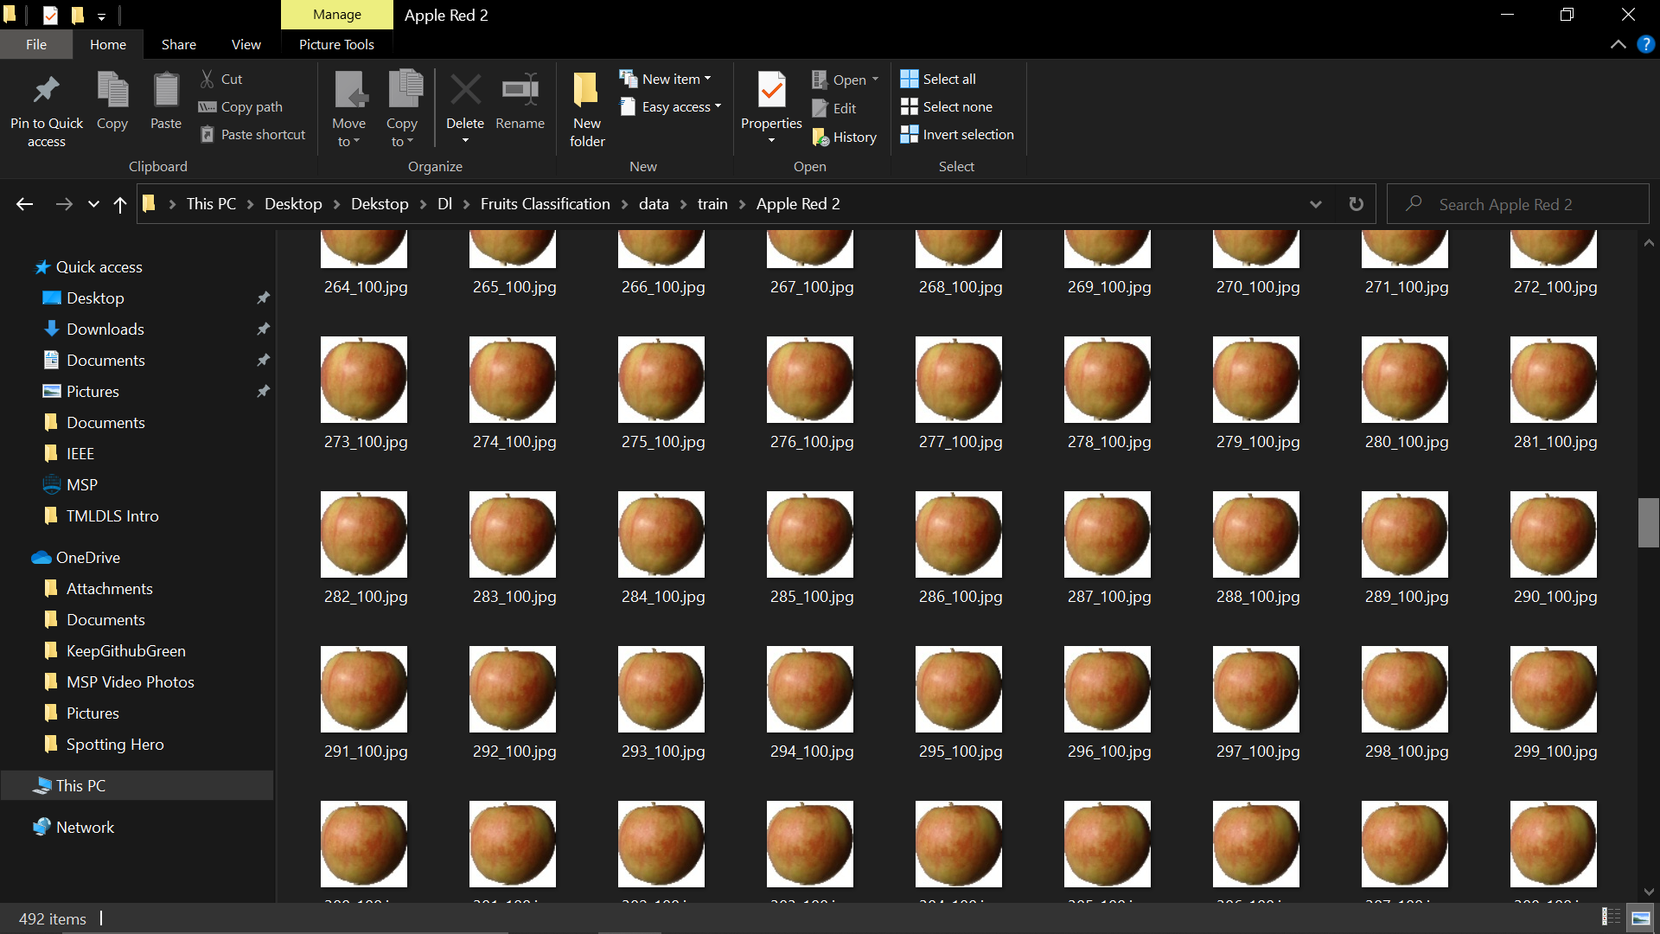
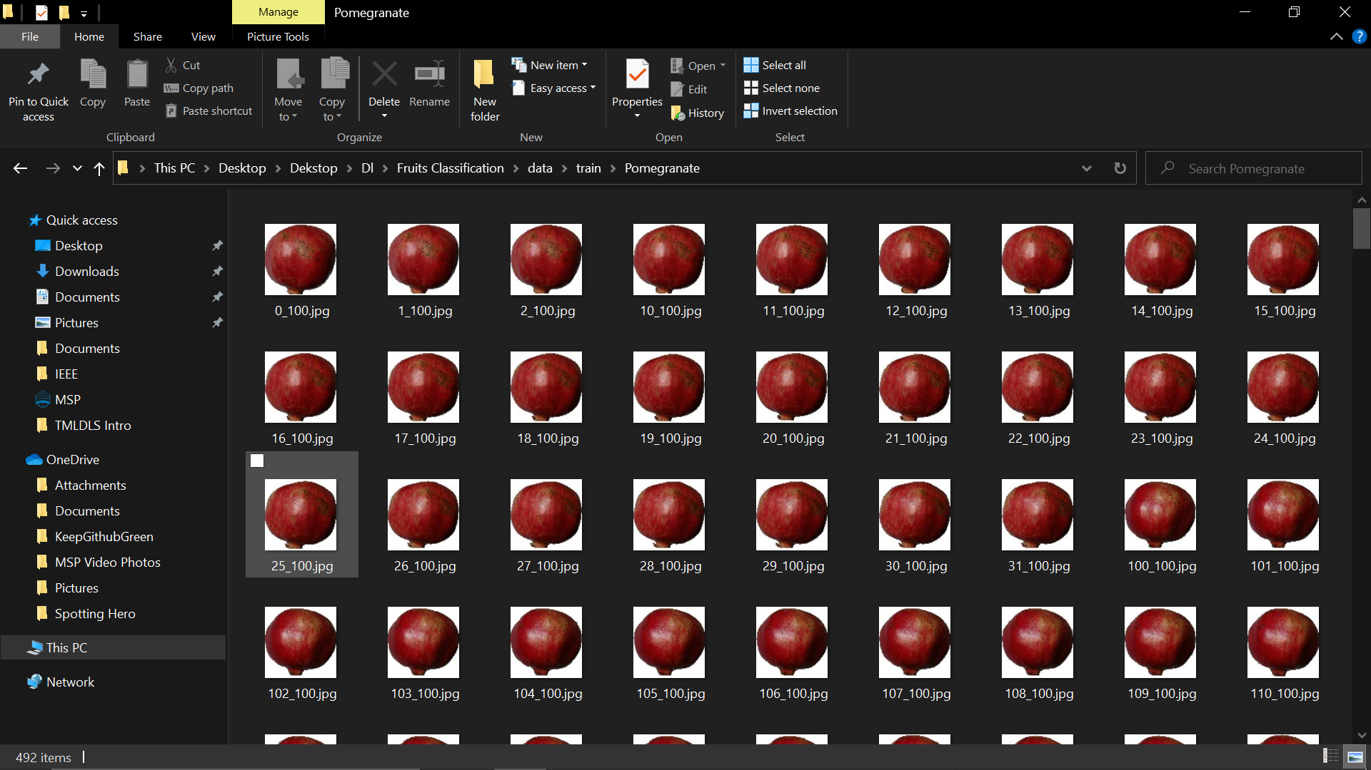
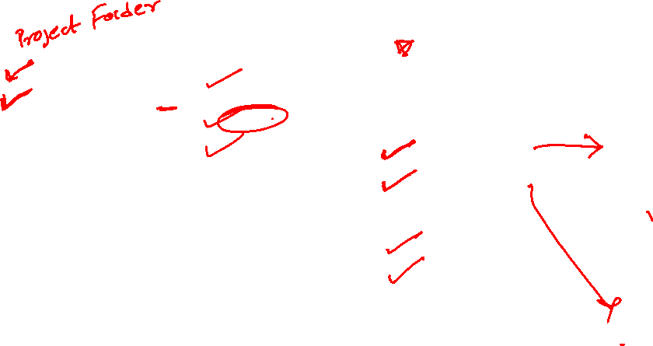
Data

Slide 10

Code
#importing all the required lib
import tensorflow as tf
from keras.preprocessing.image import ImageDataGenerator
from keras.models import Sequential
from keras.layers import Conv2D, MaxPooling2D
from keras.layers import Activation, Dropout, Flatten, Dense
from keras import backend as K
from keras.preprocessing import image
import numpy as np

Slide 11
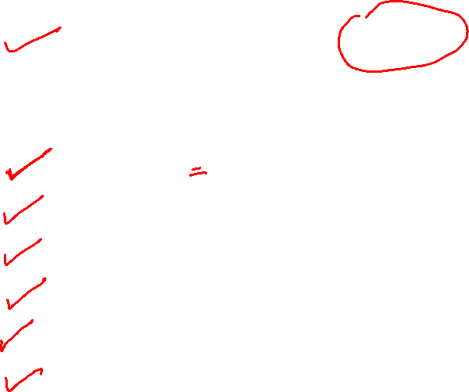
# dimensions of our images.
img_width, img_height = 150, 150
#defining the data directories
train_data_dir= 'data/train'
validation_data_dir= 'data/validation'
n_training_sample= 400
n_validation_sample= 100
epochs=40
batch_size=10

Slide 12
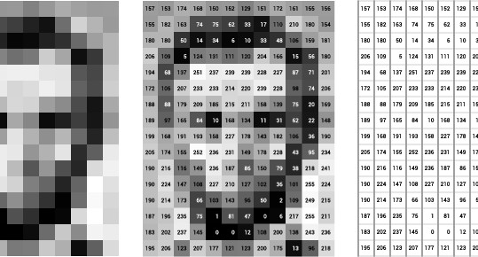
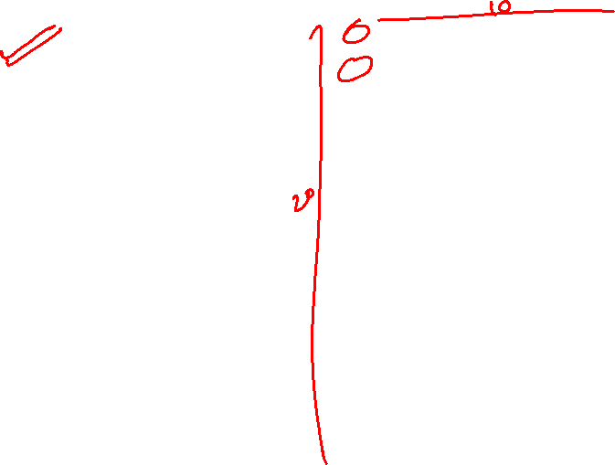
Image Data as Input (For Grayscale Image)

Slide 13
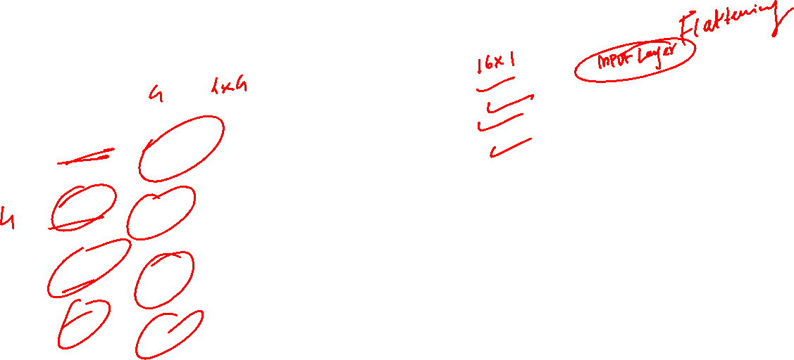
Image Data as Input (For Grayscale Image)
250
255
1
2
230
0
3
2
3
6
7
255
234
252
2
4
250
250 | 230 | 3 | 234
255 | 0 | 6 | 252
1 | 3 | 7 | 2
2 | 2 | 225 | 4
255
1
. . . . . . . . . . . . . . . . . .
4

Slide 14
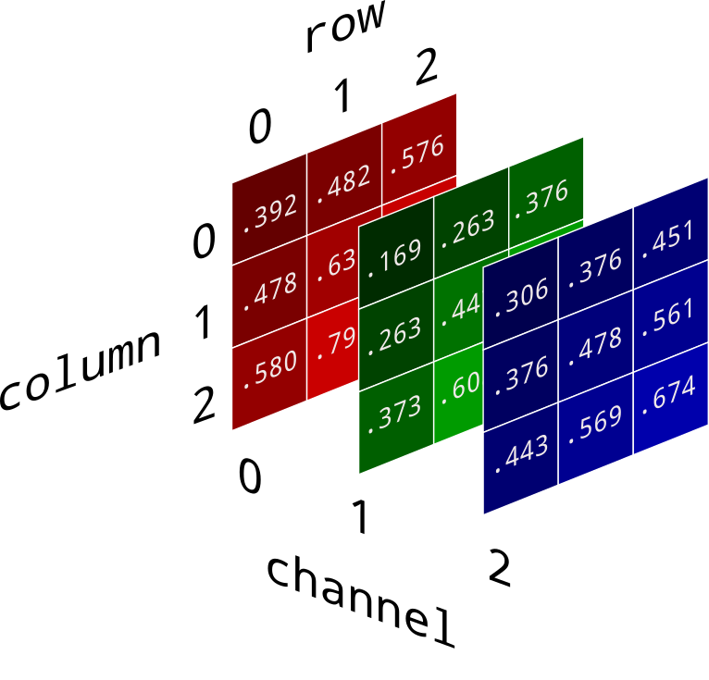
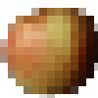
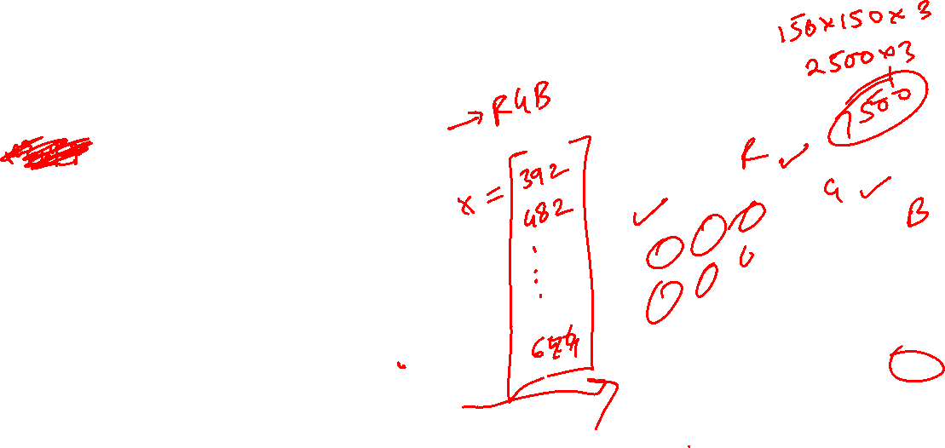
Image Data as Input (For Colour Image)
150
150

Slide 15
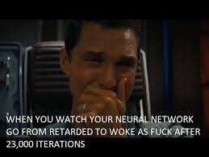

Slide 16
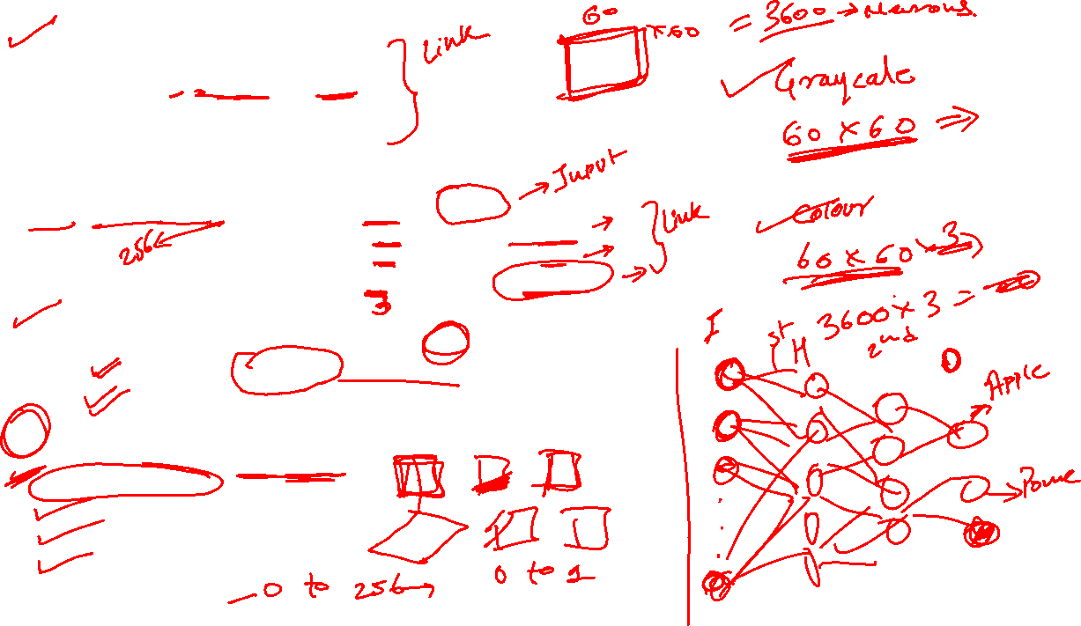
if K.image_data_format() == 'channels_first':
input_shape = (3, img_width, img_height)
else:
input_shape = (img_width, img_height, 3)
#defining the model
model = tf.keras.models.Sequential([tf.keras.layers.Flatten(),
tf.keras.layers.Dense(128, activation=tf.nn.relu),
tf.keras.layers.Dense(64, activation=tf.nn.relu),
tf.keras.layers.Dense(2, activation=tf.nn.sigmoid)])
#defining the optimizer and metrics
model.compile(optimizer = tf.optimizers.Adam(),
loss = 'sparse_categorical_crossentropy',
metrics=['accuracy'])
# this is the augmentation configuration we will use for training
train_datagen = ImageDataGenerator(
rescale=1. / 255,
shear_range=0.2,
zoom_range=0.2,
horizontal_flip=True)

Slide 17
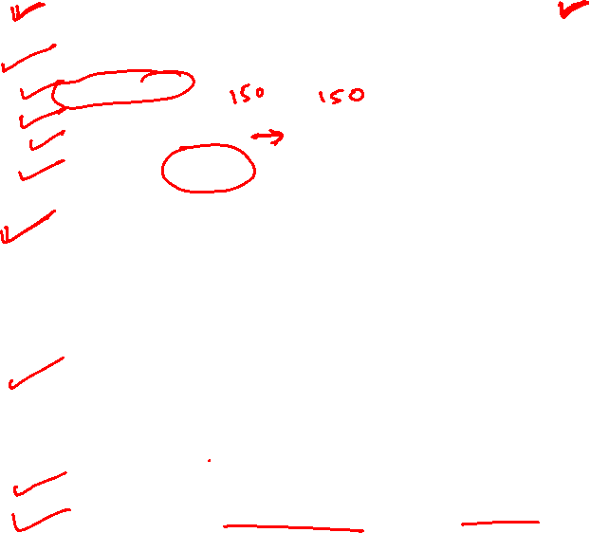
# this is the augmentation configuration we will use for testing:
# only rescaling
test_datagen = ImageDataGenerator(rescale=1. / 255)
train_generator = train_datagen.flow_from_directory(
train_data_dir,
target_size=(img_width, img_height),
batch_size=batch_size,
class_mode='binary')
validation_generator = test_datagen.flow_from_directory(
validation_data_dir,
target_size=(img_width, img_height),
batch_size=batch_size,
class_mode='binary')
model.fit_generator(
train_generator,
steps_per_epoch=n_training_sample // batch_size,
epochs=epochs,
validation_data=validation_generator,
validation_steps=n_validation_sample // batch_size)

Slide 18
Let’s Give it a Shot!!

Slide 19
Convolutional Neural Network

Slide 20

Convolutional Neural Network

Slide 21


Slide 22


Slide 23


Slide 24
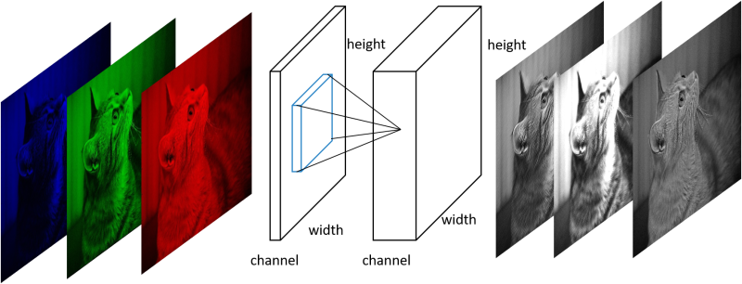
Working

Slide 25
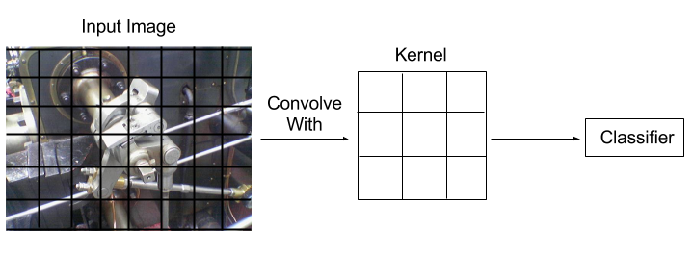
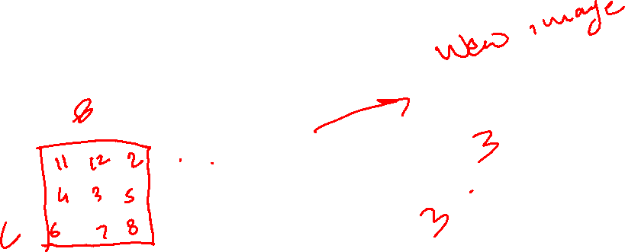
Convolution

Slide 26

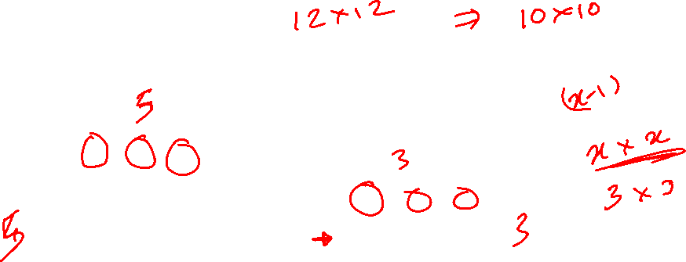
Working

Slide 27

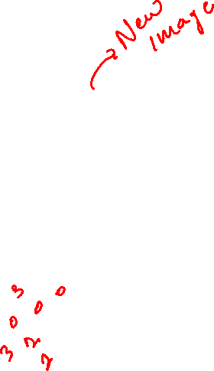
Working

Slide 28
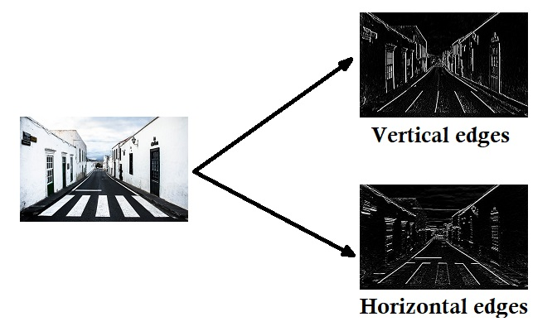
Working

Slide 29
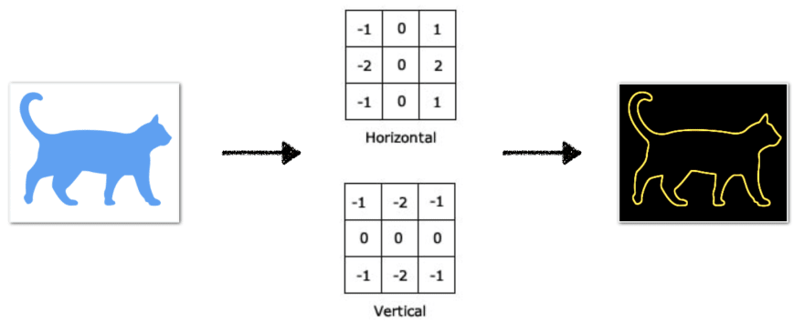
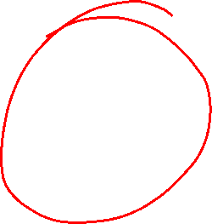
Working

Slide 30
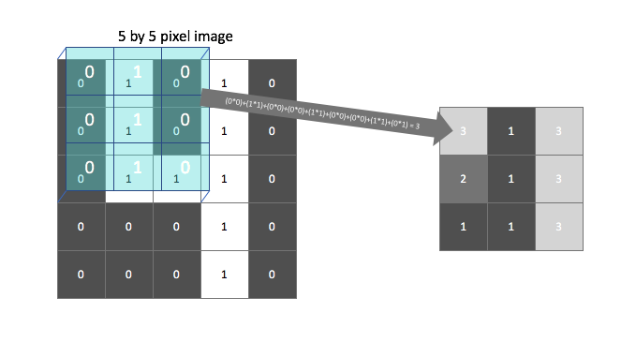
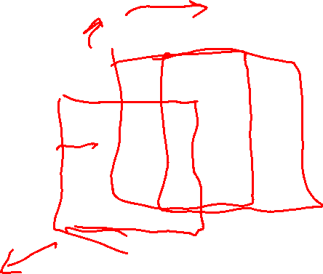
Working

Slide 31
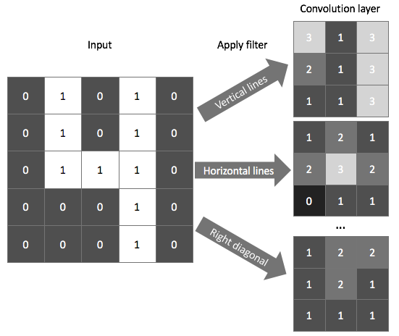
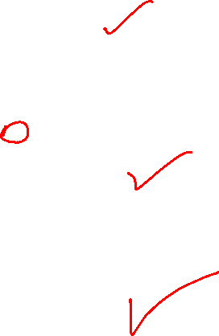
Working

Slide 32
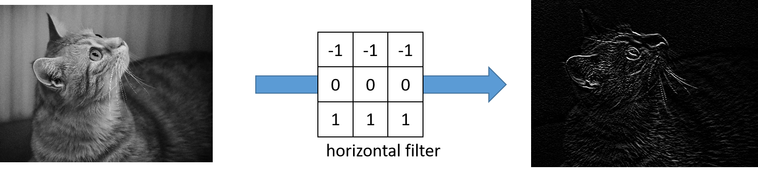
Working

Slide 33
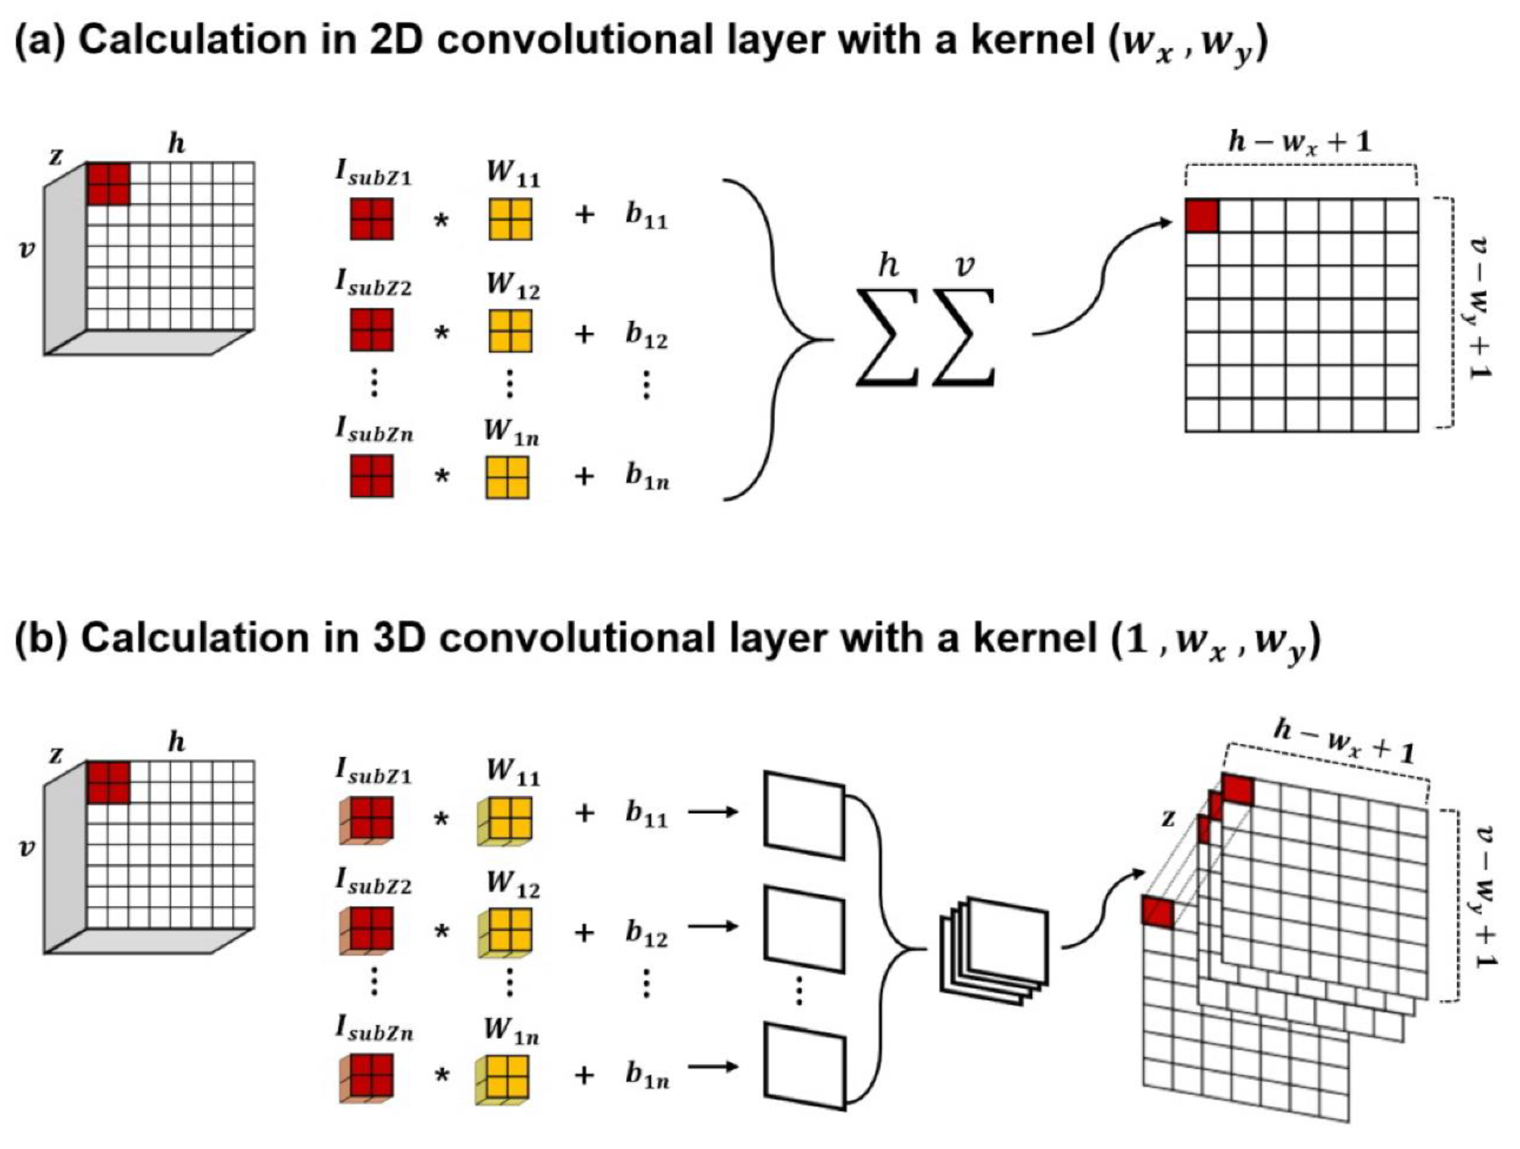
Working

Slide 34
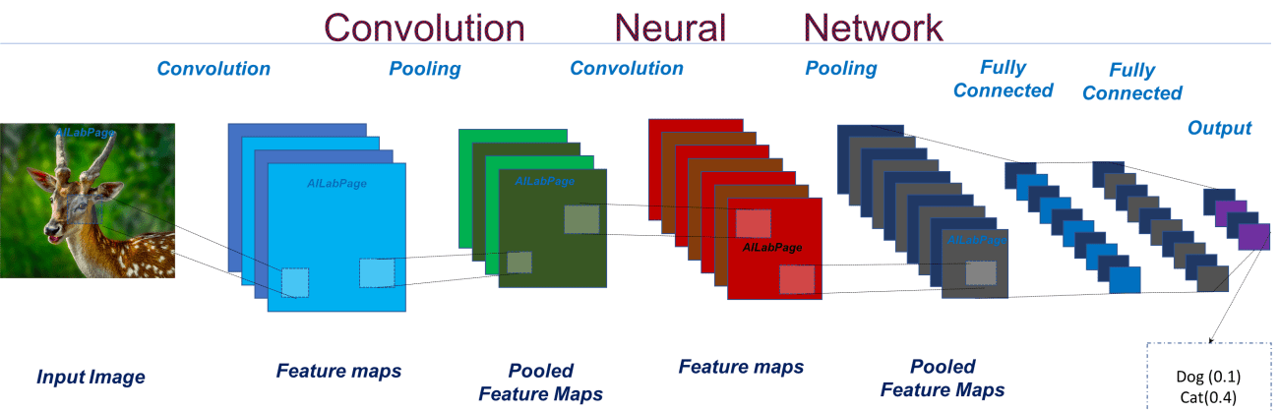
Working
Extracts the unique feature

Slide 35
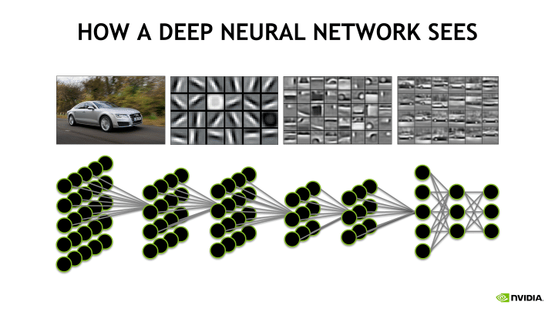
Working

Slide 36
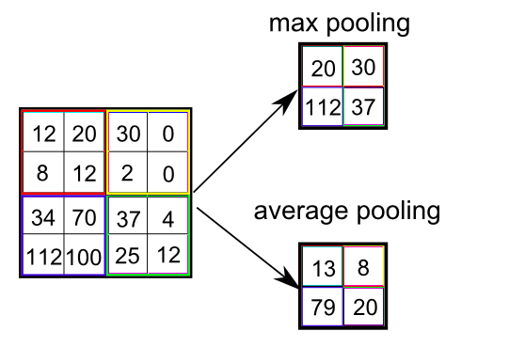
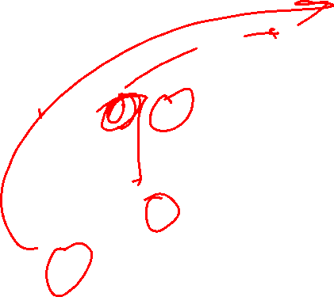
Pooling

Slide 37
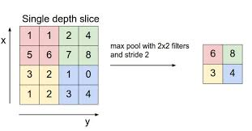
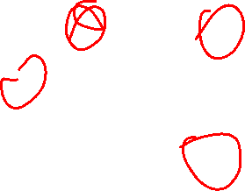
Pooling

Slide 38
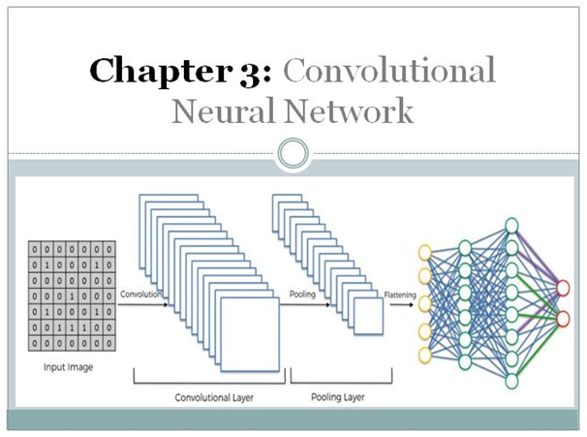
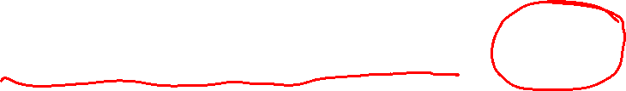
Convolution + Pooling + NN = CNN

Slide 39
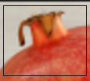
Example
This might be a unique feature

Slide 40


Slide 41


Slide 42


Slide 43
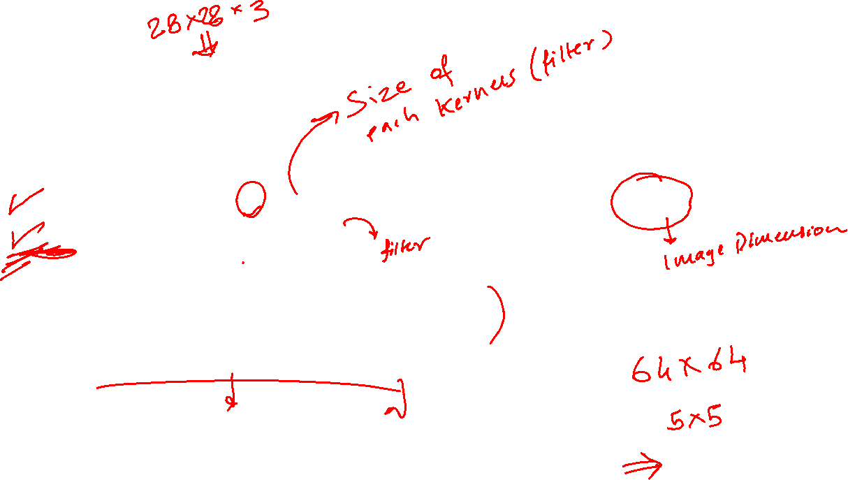
Code
#defining the model
model = tf.keras.models.Sequential([
tf.keras.layers.Conv2D(64, (3,3), activation='relu', input_shape=(28, 28, 3)),
tf.keras.layers.MaxPooling2D(2, 2),
tf.keras.layers.Flatten(),
tf.keras.layers.Dense(128, activation=tf.nn.relu),
tf.keras.layers.Dense(64, activation=tf.nn.relu),
tf.keras.layers.Dense(2, activation=tf.nn.sigmoid)])

Slide 44
Recurrent Neural Network & LSTM (Theory Only)

Slide 45


Slide 46

Recurrent Neural Networks
Understanding ML through Memes

